Slide 1




NEXT GEN EMPLOYABILITY PROGRAM
Creating a future-ready workforce
Team Members
College Name
Student Name :SURUTHI JK
Student ID :au622021104112
Paavai College Of Engineering

Slide 2

CAPSTONE PROJECT SHOWCASE
Project Title
Building Bus Reservation System using Python and Django
Abstract | Problem Statement | Project Overview | Proposed Solution | Technology Used | Modelling & Results | Conclusion

Slide 3
Abstract
The Online Bus Reservation System is a web application developed using Python and Django framework to provide a convenient and efficient way for users to book bus tickets online. This system aims to streamline the process of bus ticket booking by allowing users to search for available buses, select seats, and make reservations from the comfort of their homes. The system incorporates features such as user authentication, bus route management, seat selection, payment integration, and booking confirmation. It utilizes Django's built-in authentication system for user registration and login functionalities, ensuring security and user privacy.
Through a user-friendly interface, passengers can search for buses based on various criteria such as departure and arrival locations, date, and time. They can view available seats on selected buses and choose their preferred seats before proceeding with the reservation. Payment integration enables secure online transactions, providing users with a seamless booking experience.
Source :

Slide 4
Problem Statement
The current process of bus ticket booking often involves long queues at ticket counters, limited availability of seats, and manual paperwork, leading to inconvenience for passengers and inefficiency for bus operators. Moreover, with the increasing reliance on digital platforms for various services, there is a growing demand for online booking systems that offer convenience, flexibility, and reliability.To address these challenges, the aim is to develop an Online Bus Reservation System using Python and Django framework. The system will provide a user-friendly interface for passengers to search for available buses, select seats, and make reservations online. It will also offer administrative functionalities for bus operators to manage routes, schedules, and bookings efficiently.
Source :

Slide 5
Project Overview
The Online Bus Reservation System aims to streamline the process of booking bus tickets by providing an efficient and user-friendly online platform. Developed using Python and the Django framework, this project will cater to the needs of passengers and bus operators like.
Key Features:
User Authentication and Authorization: Secure login and registration functionality for passengers and administrators to access the system.
2. Bus Search and Booking: Passengers can search for buses based on various criteria such as origin, destination, date, and time. They can select available seats and make reservations online.
Source :

Slide 6
Proposed Solution
Project Structure and Setup: - Create a Django project with appropriate directory structure. - Set up virtual environment and install necessary dependencies such as Django, database drivers, and any additional packages for authentication and payment integration.
User Authentication and Authorization: - Implement user registration and login functionalities using Django's built-in authentication system. - Define user roles (passenger and administrator) and set permissions accordingly.
.Bus Route Management: - Create models for bus routes, including attributes such as origin, destination, departure time, and fare. - Implement CRUD (Create, Read, Update, Delete) operations for managing bus routes through the administrative interface.
Source :

Slide 7
4. Bus Schedule Management: - Define models for bus schedules, linking them to specific routes. - Allow administrators to add/edit schedules, specifying departure dates and times.
5. Seat Selection and Booking: - Develop an interactive interface for passengers to search for available buses based on criteria such as origin, destination, and date. - Display bus schedules and available seats, allowing passengers to select preferred seats. - Handle seat reservations and bookings, ensuring concurrency control to prevent double booking of seats.
6. Payment Integration: - Integrate a secure payment gateway (e.g., Stripe, PayPal) to facilitate online transactions. - Implement payment processing logic to handle successful and failed transactions, updating booking status accordingly.
7. Administrative Dashboard: - Create a dashboard for administrators to manage bus routes, schedules, fares, and bookings. - Provide functionalities for administrators to view, confirm, and cancel bookings.
Source :

Slide 8


Technology Used
Front-end
Back-end
Source :

Slide 9
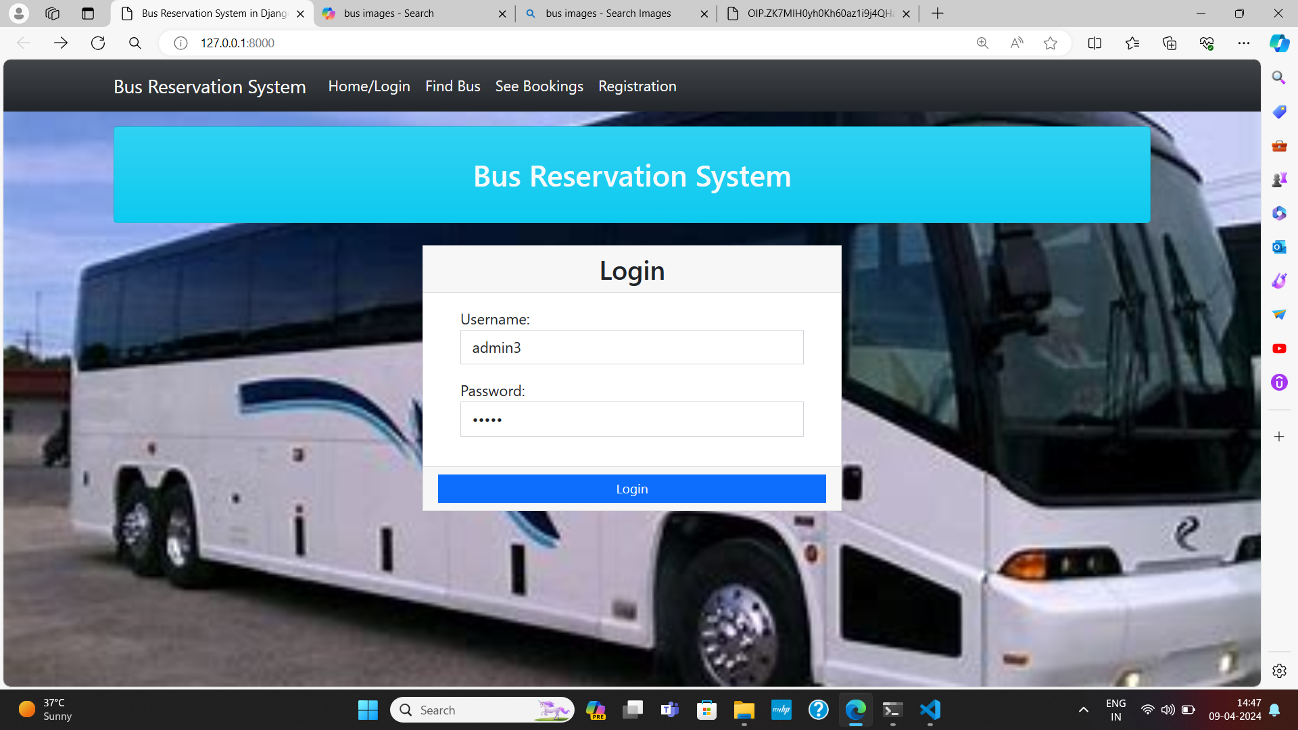
Modelling & Results
Login Page
Source :

Slide 10
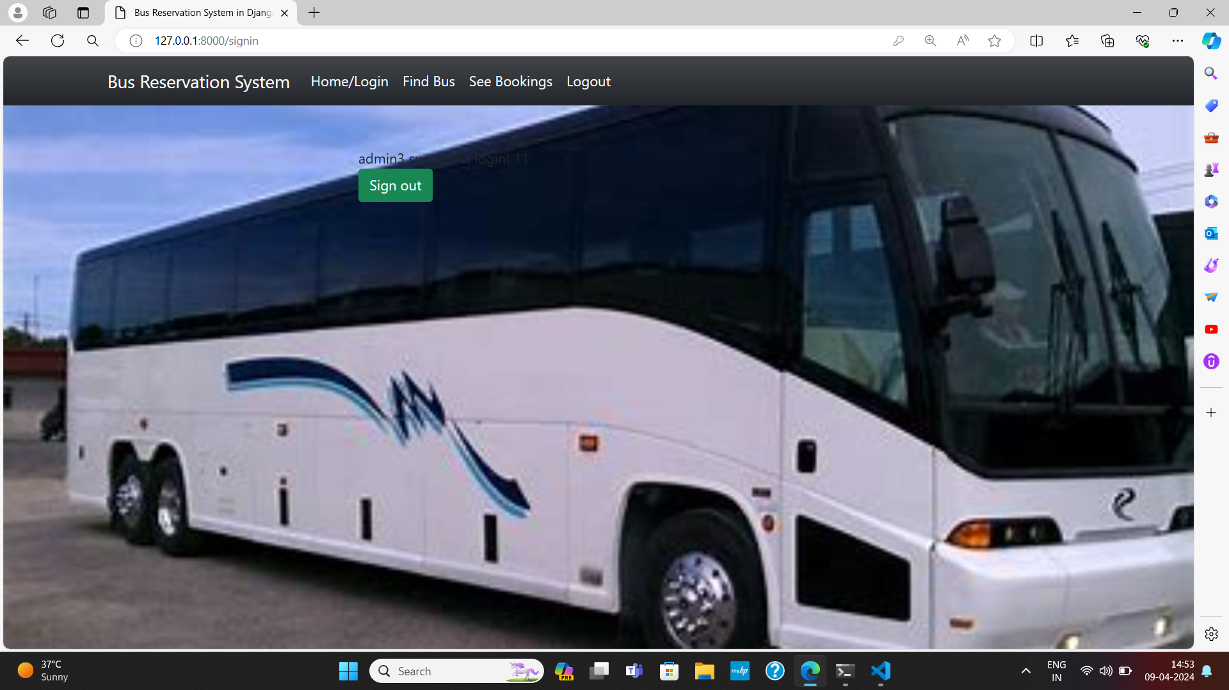
Signed in Page

Slide 11
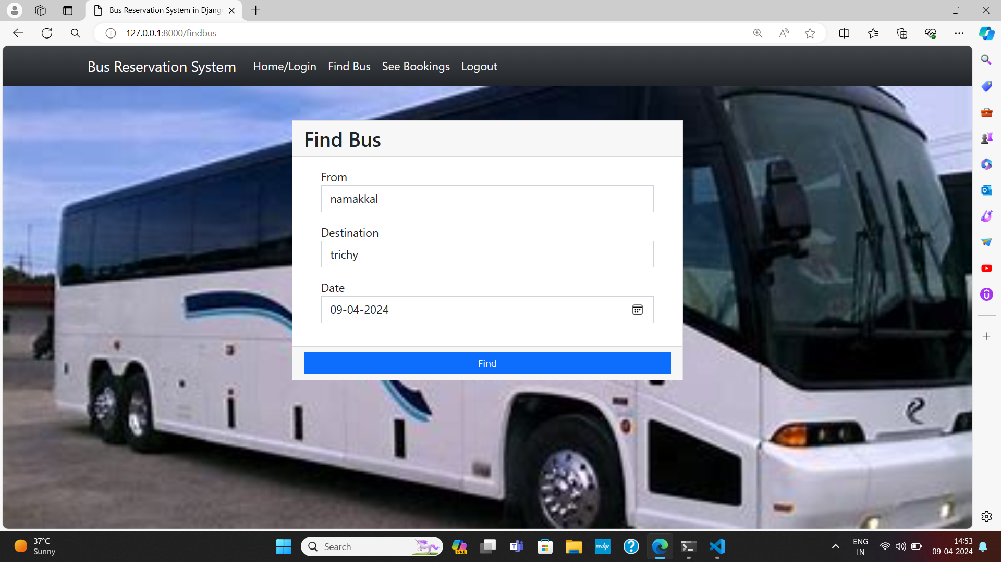
Find Bus Page

Slide 12
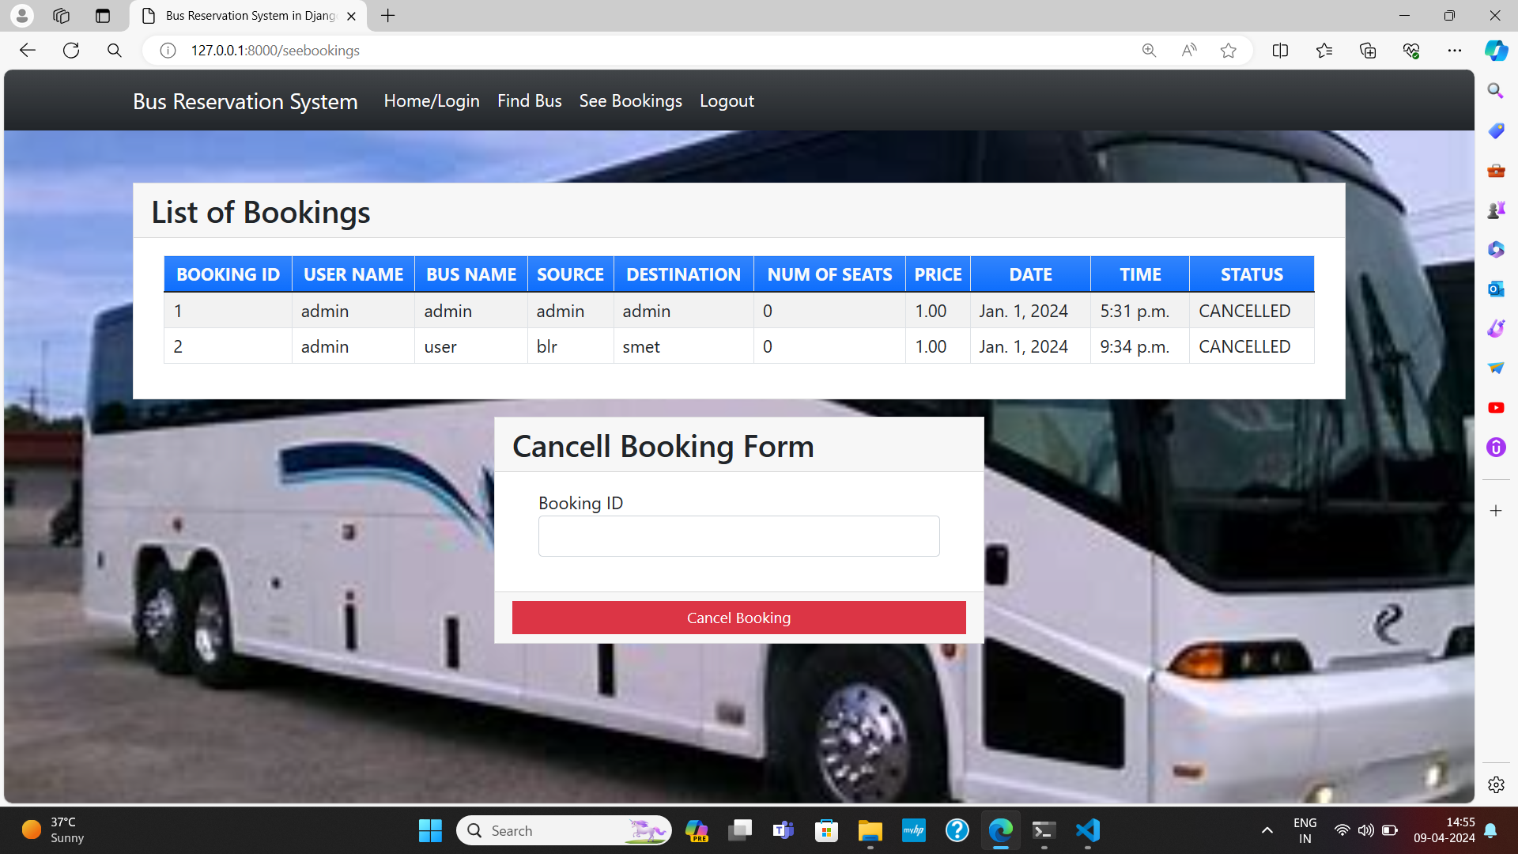
List Of Bookings

Slide 13
Conclusion
In conclusion, the bus reservation system developed using Python and Django provides a seamless and efficient platform for users to book their bus tickets online. Through the integration of Django's powerful features such as ORM, forms, and authentication, along with Python's flexibility, the system offers users a user-friendly interface to search for buses, select seats, and make payments securely. Additionally, the system allows administrators to manage buses, routes, and bookings efficiently. Overall, the bus reservation system serves as a robust solution for streamlining the booking process, enhancing user experience, and improving operational efficiency for both users and administrators.
Source :

Slide 14
Thank You!
Notes:
Thank You !!

